Slide 1
Class and Interface Design
Dirk Riehle, FAU Erlangen
ADAP B02
Licensed under CC BY 4.0 International

Slide 2
Agenda
Classes vs. interfaces
Abstract state model
Program to an interface
Design by primitives
Simple class design
Inheritance interface
Class design evolution
Homework

Slide 3
1. Classes vs. Interfaces

Slide 4
Objects and Classes
The modeling perspective (historically: Simula)
An object is the representation of a phenomenon from a domain
A class is a description of the commonalities of similar objects
The technology perspective (historically: Smalltalk)
An object is an encapsulation of some program state
A class is the implementation of how to change that state

Slide 5
Classes and Interfaces
An interface is
The abstract description of some object behavior
An abstract class is
A partial implementation of an interface’s behavior
An concrete class is
A complete implementation of an interface’s behavior

Slide 6
(Use-Client) Interfaces
Have an abstract state model and state transitions
Are to be implemented by abstract and/or concrete classes

Slide 7
Abstract Classes
Set up algorithmic scaffolding for concrete subclasses
Are used to implement an interface, to be extended by subclasses

Slide 8
Concrete Classes
Include implementation state (fields)
Directly implement an interface or extend an abstract class
When paired with an interface, are also known as implementation classes

Slide 9
In Typescript
A Typescript interface is a (use-client) interface
Any Typescript class has an (implicit) interface
The interface is conceptually separate from the implementation
In other languages, e.g. C, interface and implementation are split in files
A Typescript class can implement a Typescript interface
A Typescript class can be an abstract class
The marked as abstract in its definition

Slide 10
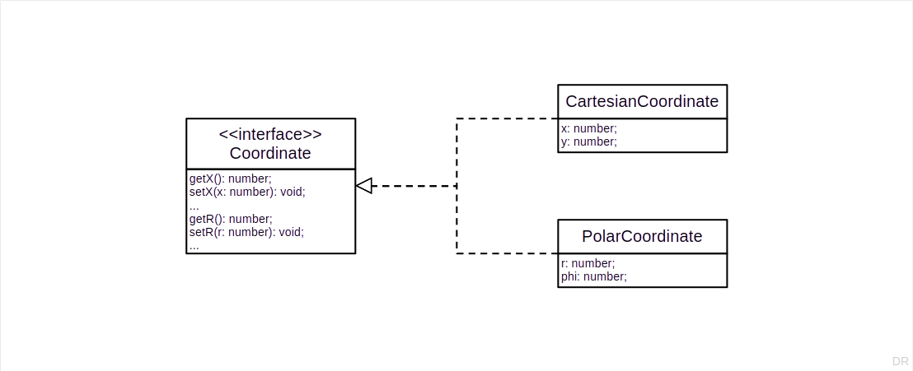
Class Model of Coordinates Example

Slide 11
2. Abstract State Model

Slide 12
Abstract State Model
An abstract state model is
A model of the valid state space of objects conforming to the model
An interface expresses an abstract state model
An abstract state model does not map 1:1 on implementation fields
The abstract state model can be expressed using get methods
Alternatively, it can be expressed as finite state machines

Slide 13
State Model of Coordinate Example
import { Equality } from "./Equality";
import { Cloneable } from "./Cloneable";
export interface Coordinate extends Equality, Cloneable {
...
getX(): number;
getY(): number;
...
getR(): number;
getPhi(): number;
...
}

Slide 14
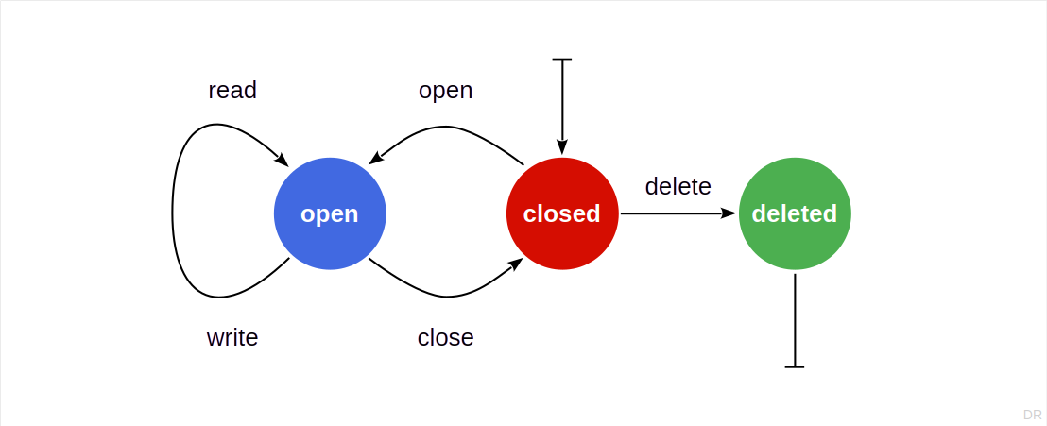
State Model of File Example

Slide 15
File as Class (+ Interface)
export class File {
public isOpen(): boolean { ... }
public isClosed(): boolean { ... }
public read(): any[] {
this.assertIsOpenFile();
...
}
public delete(): void {
this.assertIsClosedFile();
...
}
protected assertIsOpenFile(): void { ... }
protected assertIsClosedFile(): void { ... }
...
}

Slide 16
File Interface and ObjFile Implementation
export interface File {
isEmpty(): boolean;
isOpen(): boolean;
isClosed(): boolean;
read(): any[];
write(data: any[]): void;
delete(): void;
}
export class ObjFile implements File {
protected data: Object[] = [];
protected length: number = 0;
public isEmpty(): boolean {
return this.length == 0;
}
public read(): Object[] { ... }
public write(data: Object[]): void { ... }
public delete(): void { ... }
...
}

Slide 17
3. Program to an Interface

Slide 18
The Program to an Interface Principle
Program to an interface, not an implementation

Slide 19
How to Program to an Interface
Program to the abstract state model
Do not program to the implementation state
Do not rely on what is not in the interface
Do not expect implementation-generated side-effects
Do not rely on specific performance unless guaranteed

Slide 20
Class Implementation
A concrete class (a.k.a. implementation class)
Has an interface that combines all interfaces it implements
Is a complete implementation of that interface
Implements an abstract state model
The implementation is by way of implementation state (fields)

Slide 21
4. Design by Primitives

Slide 22
Types of Interfaces
Use-client interfaces
Inheritance interfaces

Slide 23
Design by Primitives
Design by primitives is a programming principle in which
The implementation state of a class is encapsulated by primitive methods
All other methods should utilize these primitive methods
Do not change any fields outside the primitive methods

Slide 24
Use of Primitive Methods
public getX(): number {
return this.doGetX();
}
protected doGetX(): number {
return this.x;
}
public getR(): number {
return Math.hypot(this.doGetX(), this.doGetY());
}
public setR(r: number): void {
let phi: number = Math.atan2(this.doGetY(), this.doGetX());
this.doSetX(r * Math.cos(phi));
this.doSetY(r * Math.sin(phi));
}

Slide 25
The Purpose of Design by Primitive
The encapsulation of implementation field access creates an indirection level that
Creates flexibility (subclasses can override)
Makes design by contract more effective

Slide 26
5. Simple Class Design

Slide 27
How to Structure a Class Interface
Group methods by trait or collaboration
Get and set belong together, not getters and setters
Methods of the same collaboration belong together
Special purpose methods belong together
Break out reusable collaborations as interfaces

Slide 28
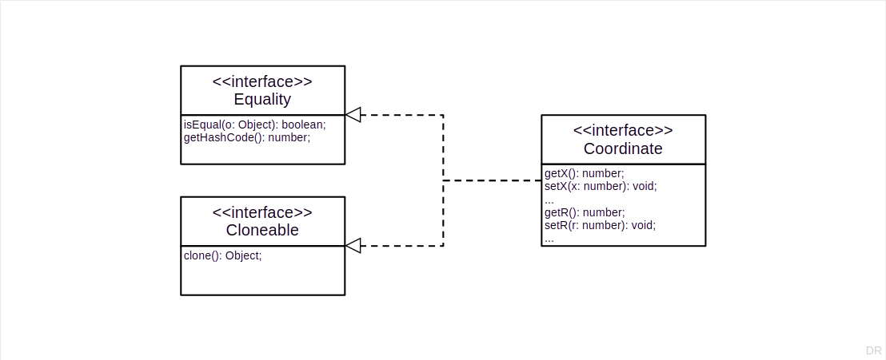
Multiple Interfaces

Slide 29
How to Structure a Class Implementation
Group fields together, across traits or collaborations
At top of file (most common) or bottom (less common)
Because implementation state works across collaborations

Slide 30
Tagging Interface
A tagging interface is
An interface that serves as a marker to the compiler to add “some magic”
Typically void of any methods
A.k.a. marker interface
In Java, example tagging interfaces are Cloneable and Serializable

Slide 31
6. Inheritance Interface

Slide 32
Inheritance Interface
An inheritance interface is
An internal abstract interface defined by a superclass for its own use
To be implemented by subclasses to complete the implementation

Slide 33
Design of Inheritance Interfaces
The inheritance interface
Typically consists of primitive methods
Is protected (only for class internal use)

Slide 34
Inheritance Interface of AbstractCoordinate
export abstract class AbstractCoordinate implements Coordinate {
...
protected abstract doGetX(): number;
protected abstract doSetX(x: number): void;
protected abstract doGetY(): number;
protected abstract doSetY(y: number): void;
protected abstract doGetR(): number;
protected abstract doSetR(r: number): void;
protected abstract doGetPhi(): number;
protected abstract doSetPhi(phi: number): void;
}

Slide 35
Narrow Inheritance Interface Principle
Inheritance interfaces should be as small (narrow) as possible
Small = minimal number of methods needed to complete the implementation
This allows for expedient implementation of subclasses
Subclasses can still override more methods for more efficient implementations

Slide 36
Thinking the Class Hierarchy Bottom-up
Subclasses call methods of superclasses to use its functionality
This may be any kind of method including helper methods

Slide 37
Thinking the Class Hierarchy Top-down
Superclasses implement algorithms (for example, as template methods)
Superclasses call methods of subclasses through the inheritance interface
This reuses algorithms while allowing for behavior variation of the algorithms

Slide 38
The Open / Closed Principle
A class should be open for extension and closed for modification
Open for extension through a well-defined inheritance interface
Closed for modification by not violating the use-client interface

Slide 39
7. Class Design Evolution

Slide 40
Typical Class and Interface Evolution
Simple class
Interface extraction
Addition of implementation classes
Introduction of reusable abstract superclass

Slide 41

1. Simple Class

Slide 42
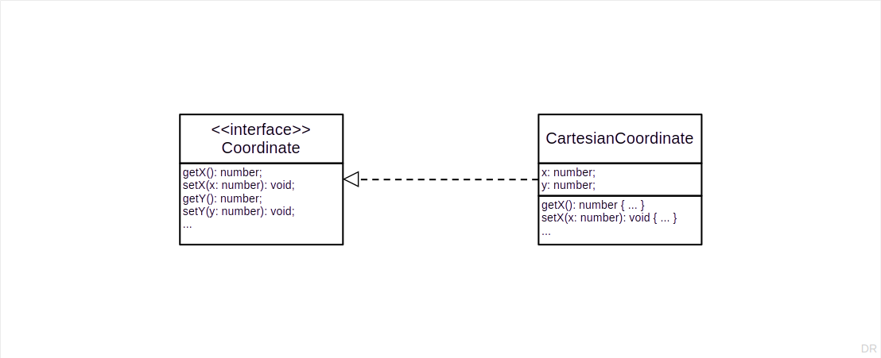
2. Interface Extraction

Slide 43
3. Addition of Implementation Classes

Slide 44
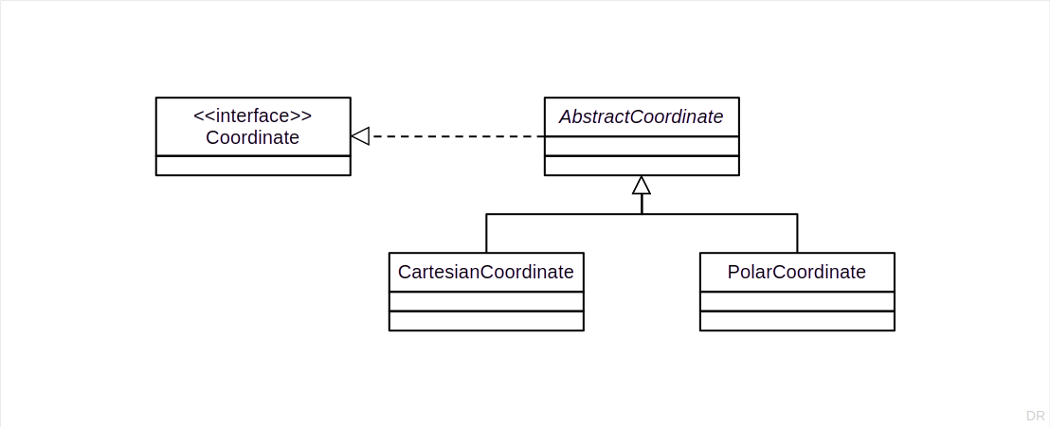
4. Introduction of Abstract Superclass

Slide 45
Naming Conventions of Classes
Recommended
Interfaces
Coordinate
Abstract classes
AbstractCoordinate
Concrete classes
DefaultCoordinate
GenericCoordinate
CartesianCoordinate
PolarCoordinate
Discouraged
Interfaces
ICoordinate
Abstract classes
CoordinateImpl
Concrete classes
CartesianCoordinateImpl
...

Slide 46
How to Name Classes (English Grammar)
It is best to go with the flow of the (English) language chosen by your project
General rule: Adjective sequence + class name
Ordering of adjective: By how strongly they bind
Opinion, size, age, shape, color, origin, material, purpose
Examples
FunnyLargeRipeStraightYellowJamaicanSoftEdibleBanana
LargeEuropeanWoodenRockingChair

Slide 47
Homework

Slide 48
Homework Instructions
Split Name class into Name interface and StringArrayName class
StringArrayName uses a string[] as the internal representation of a name
Add a StringName class that represents a name as a single string
Ensure that Name instances can be used interchangeably
Adapt your previous work to this homework as you see fit
Commit homework by deadline to homework repository

Slide 49
Summary
Classes vs. interfaces
Abstract state model
Program to an interface
Design by primitives
Simple class design
Inheritance interface
Class design evolution

Slide 50
Thank you! Any questions?
dirk.riehle@fau.de – https://oss.cs.fau.de
dirk@riehle.org – https://dirkriehle.com – @dirkriehle

Slide 51
Legal Notices
License
Licensed under the CC BY 4.0 International license
Copyright
© 2012, 2018, 2024 Dirk Riehle, some rights reserved

